Slide 1
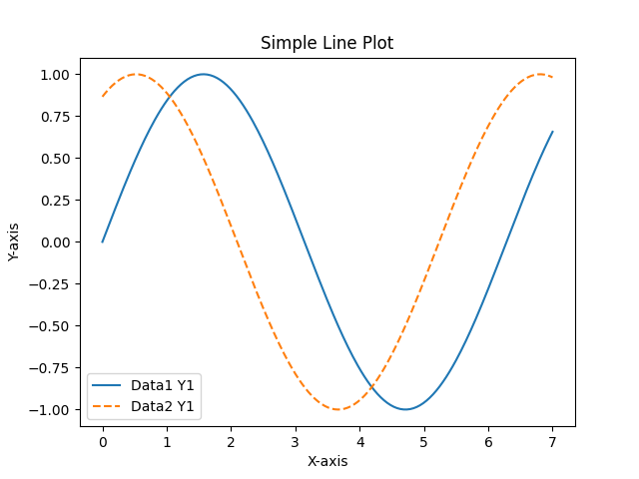
Simple Line Plot

Slide 2
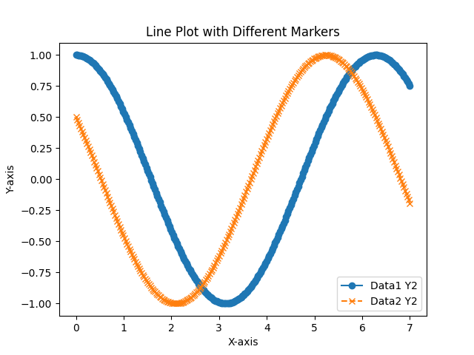
Line Plot with Different Markers

Slide 3
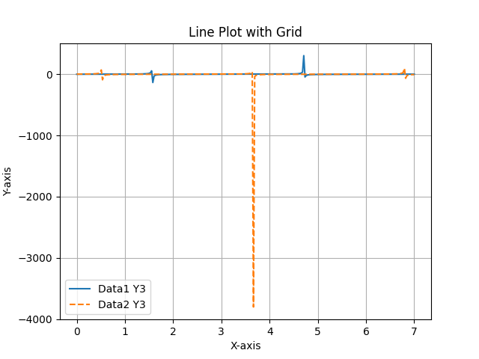
Line Plot with Grid

Slide 4
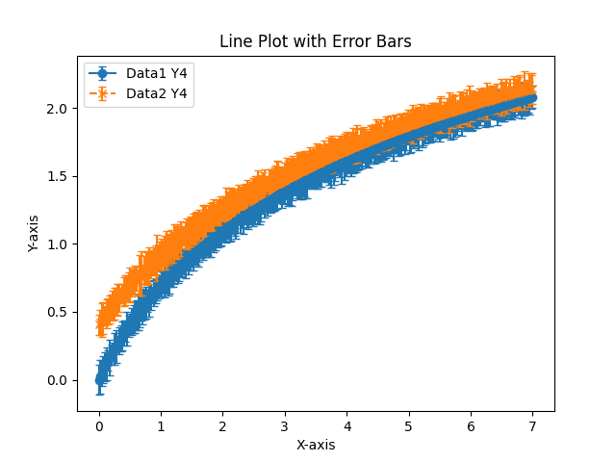
Line Plot with Error Bars

Slide 5
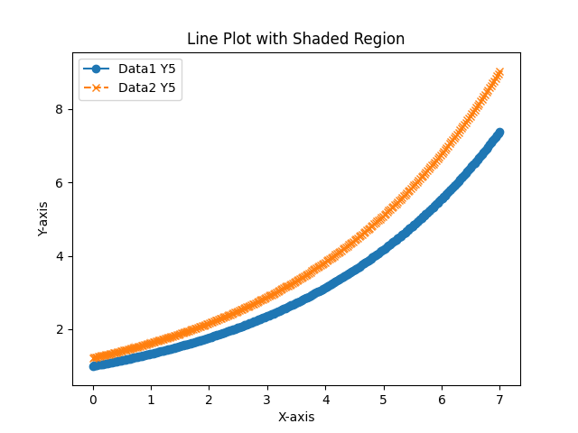
Line Plot with Shaded Region

Slide 6
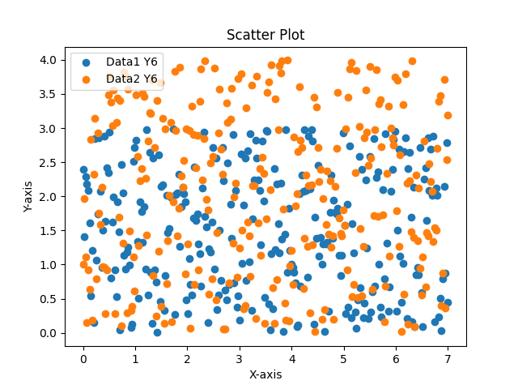
Scatter Plot

Slide 7
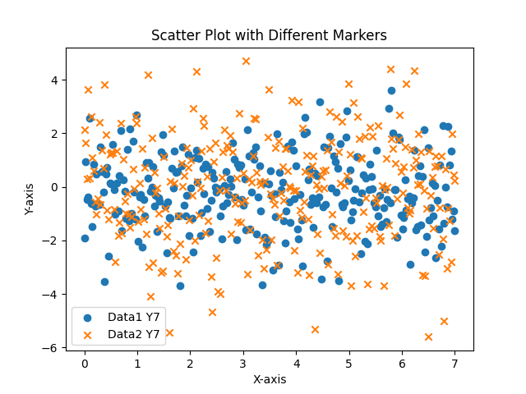
Scatter Plot with Different Markers

Slide 8
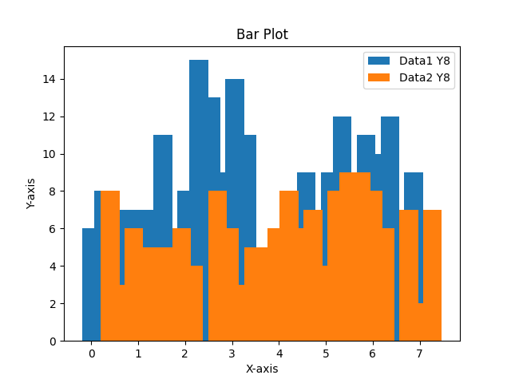
Bar Plot

Slide 9
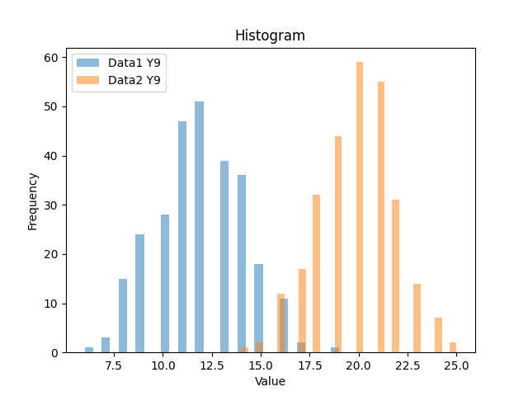
Histogram

Slide 10
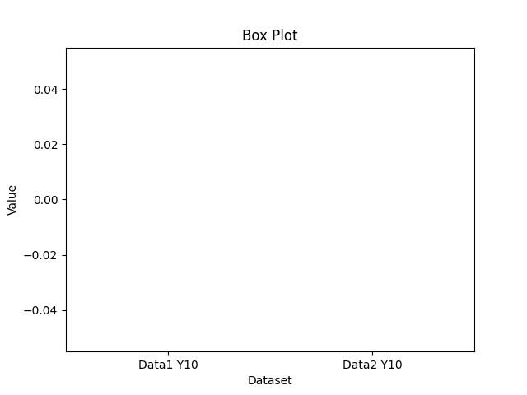
Box Plot

